Slide 1
Data Integrity
IN705 2018 Session 10.1
Notes:
Some content based loosely on Rob and Coronel Ch.10
Note that the SQL issues discussed today (locking and transactions) are not required in your project. You need to understand the issues, but the details of implementation are out of scope for this paper
Note also that these issues are very complex and math-heavy. We are getting an overview so you can be aware of the issue involved. More reading is available if you are interested.

Slide 2
Maintaining Data Integrity
Design
Checks and constraints
Referential integrity control
Normalisation
Concurrency control
Insures that multiple user access does not lead to data anomalies
Disaster Recovery
Restores the database contents in the event of catastrophic hardware or software failure
Notes:
We have gone over the first one already
The second topic looks at how to manage normal simultaneous data access
The third looks at how to be sure that you can get your database back if something really bad happens

Slide 3
Transaction Management
Transaction:
A logical unit of work on the database that must be treated as indivisible in order to maintain the database in a correct state.
That is, either all operations of the transaction must happen, or none must happen.
Notes:
Concurrency and recovery are closely related in that both deal with the notion of “transaction management”
That is, by insuring the correctness of transactions against the database, we insure the integrity of the database as a whole
So we start here with a discussion of the concept of a transaction.
As we move on to the technical details of concurrency and recovery, we will see the way in which they are both centred on the transaction
Transactions are logical entities. In practice, a transaction is composed of one or more database operations

Slide 4
Example
Assume an inventory and billing database
Customer C_001 purchases 25 units of item XYZ.
The following operations must all occur:
The order table must be updated to show the purchase
The inventory entry of item XYZ must be reduced by 25
The purchase price must be added to the account balance of customer C_001.
Notes:
If the database is in a consistent and correct state, and if all three operations happen, the database is still in a consistent and correct state
If only a subset of the operations happen, the database is not consistent. For example, if the inventory is not decremented, your database will show 25 more units of XYZ than actually exist.
Thus these three operations together (or, more technically the SQL statements that implement them) form a transaction.

Slide 5
Essential Transaction Properties
Atomicity
Consistency
Isolation
Durability
Serialisability
Notes:
With the traditional mnemonic
To guarantee database correctness, all these properties must be true for each transaction
If you can’t do this, your DBMS is a fail

Slide 6
Essential Transaction Properties
Atomicity
Either all the operations or none of the operations in the transaction must be performed.
Notes:
This is sort of the definitional property

Slide 7
Essential Transaction Properties
Consistency
If the database is consistent prior to execution of a transaction, it must be consistent after execution of a transaction
Notes:
Note that the database need not be consistent during the transaction
For example, if you are transferring money from one bank account to another, in between the moment you decrement account 1, and the moment when you increment account 2, the database will be wrong. That’s ok.

Slide 8
Essential Transaction Properties
Isolation
The data used by a transaction is isolated from any other transactions.
Notes:
If T1 is updating some data element, T2 can’t use it
Note that isolation can be relaxed if the transactions are only reading a data element
We will see how this is implemented later.

Slide 9
Essential Transaction Properties
Durability
Once a transaction makes its final changes to the database, those changes cannot be undone or lost, even if the system fails
Notes:
Changes persist.
Note that transactions can be stopped in the middle, in which case, some modifications they might have made are undone (on rollback).
But once the whole transaction is enacted (committed), the effect is forever.

Slide 10
Essential Transaction Properties
Serialisability
The concurrent execution of any set of transactions {T1 ,T2,T3…Tn}, must produce the same database state as if the transactions had been run in serial.
Notes:
Note that certain orders of transactions may not be legal due to business rules (e.g. if your bank balance is not allowed to go negative), but that doesn’t really matter.
This is about mathematical outcomes.

Slide 11
Essential Transaction Properties
Atomicity
Consistency
Isolation
Durability
Serialisability
Notes:
Obviously, we don’t worry about isolation and serialisability in a single user database.
But most databases these days are multi-user, we worry about them a lot.

Slide 12
Defining Transactions in SQL
BEGIN TRANSACTION
COMMIT
Indicates successful termination of the transaction
Modifications can be made permanent
ROLLBACK
Indicates unsuccessful termination (failure) of the transaction
Any modifications made must be undone
Notes:
Deciding when a set of operations must be treated as a transaction (i.e. an indivisible logical unit) is often the programmer’s responsibility
In SQL, you indicate this via the three commands shown
Note that the syntactic detail will vary from DBMS to DBMS. Look it up for your system
We will talk about the “can be made permanent” thing a bit later

Slide 13
Example
Assume a supplier SP_001 has delivered 1000 units of product XYZ.
BEGIN TRANSACTION
Insert (SP_001, 1000,XYZ) into tbl Shipment
If error, ROLLBACK
Insert (XYZ, qtyXYZ + 1000) into tblInventory
If error, ROLLBACK
COMMIT
END TRANSACTION
Notes:
We need to update the shipment table and the inventory table, not just one
In pseudocode, we would write.
As we will see later, part of database recovery is that the DBMS keeps a log of all the transactions that have happened since an earlier point in time.
It can use this log to reconstruct the database in the case of catastrophic failure.

Slide 14
Concurrency Control
When multiple transactions are executing against the database simultaneously, bad things can happen.
Notes:
We will discuss these problems in the context of just two transactions at a time.
Feel free to imagine what happens with 1000s

Slide 15
Lost Update
Assume:
T1: qtyXYZ = qtyXYZ + 125
T2: qtyXYZ = qtyXYZ - 15
Serial Execution
Time | Xaction | Operation | qtyXYZ
1 | T1 | Read qtyXYZ | 40
2 | T1 | qtyXYZ += 125
3 | T1 | Write qtyXYZ | 165
4 | T2 | Read qtyXYZ | 165
5 | T2 | qtyXYZ -= 15
6 | T2 | Write qtyXYZ | 150
Notes:
Assume two transactions update the value of some field
Ideally, or if these transactions ran in serial, after they were finished , qtyXYZ would be greater by 110
Let assume qtyXYZ starts at 40

Slide 16
Lost Update
Assume:
T1: qtyXYZ = qtyXYZ + 125
T2: qtyXYZ = qtyXYZ - 15
Parallel Execution (possible sequence)
Time | Xaction | Operation | qtyXYZ
1 | T1 | Read qtyXYZ | 40
2 | T2 | Read qtyXYZ | 40
3 | T1 | qtyXYZ += 125 (165)
4 | T2 | qtyXYZ -= 15 (25)
5 | T1 | Write qtyXYZ | 165
6 | T2 | Write qtyXYZ | 25
Notes:
But assume the transactions are running at the same time
In this case, the operations can be interleaved
Oops

Slide 17
Uncommitted Data
Anomaly when a transaction rolls back
Serial Execution
Time | Xaction | Operation | qtyXYZ
1 | T1 | Read qtyXYZ | 40
2 | T1 | qtyXYZ += 125
3 | T1 | Write qtyXYZ | 165
4 | T1 | ROLLBACK | 40
5 | T2 | Read qtyXYZ | 40
6 | T2 | qtyXYZ -= 15
7 | T2 | Write qtyXYZ | 25
Notes:
Another bad thing that can happen
One transaction starts and modifies some data, then for some reason, terminates and rolls back (maybe it modifies multiple values and couldn’t get to one of the other ones.)
Here’s how it should work…

Slide 18
Uncommitted Data
Parallel Execution (possible sequence)
Time | Xaction | Operation | qtyXYZ
1 | T1 | Read qtyXYZ | 40
2 | T1 | qtyXYZ += 125 (165)
3 | T1 | Write qtyXYZ | 165
4 | T2 | Read qtyXYZ | 165
5 | T2 | qtyXYZ -= 15 (150)
6 | T1 | ROLLBACK
7 | T2 | Write qtyXYZ | 150
Notes:
Here’s what can happen…

Slide 19
Inconsistent Retrieval
Let
Balance1 = 40
Balance2 = 50
Balance3 = 30
Transaction 1 is calculating the sum of all balances (should be 120)
Transaction 2 is moving $10 from account 3 to account 1 (so the three balances will end up at 50, 50, and 20 respectively)
Notes:
When one transaction is retrieving data at the same time that another is updating it...

Slide 20
Inconsistent Retrieval
Balance 1 = 40 Balance2 = 50 Balance3 = 30
Xact 1 | Time | Xact2
Read balance 1; sum = 40 | 1
Read balance2; sum = 90 | 2
 | 3 | Read balance 3 = 30
 | 4 | Decrement and write balance 3 -> 20
 | 5 | Read balance 1 = 40
 | 6 | Increment and write balance 1 -> 50
 | 7 | COMMIT
Read balance 3; sum = 110 | 8
Notes:
A different sort of transaction diagram; you will see these more often
Time moves down
We’ve squashed multiple operations into single time units to fit on the screen
Note that each transaction did exactly what it was supposed to
The final balances are correct
Unfortunately, the total is off by 10. Your total is not equal to the sum of your accounts.

Slide 21
Preventing Concurrency Failures
Don’t allow concurrent transactions
Implement a concurrency control protocol
Locking
Timestamp Ordering
Optimistic
Notes:
Method 1 will work, but your database will be slow.
While a transaction is waiting for data, many CPU cycles will go by unused. This is bad.
Better to implement a concurrency control protocol.
The software module responsible for this is usually called the Scheduler.
Different DBMS take difference approaches
Note that concurrency management is an active research area. People are busy trying to work out new and better ways of handling this problem. We will look at three methods here; each has strengths and weaknesses
Note that in modern databases, the problem is becoming even more complex as the DBMS itself becomes a multithreaded piece of software, introducing a whole new level of problems.
You will see this in more detail in the DBA pracs

Slide 22
Concurrency Protocol 1: Locking
A transaction acquires a lock on a database object it needs to use.
While the object is locked, other transactions have only restricted access to it
Notes:
The most basic approach
The definition of “database object” is one of the parameters of the protocol: field? record? table?
We discuss this more later.

Slide 23
Locking
Types of locks:
Shared:
Requested when the object is to be read
Exclusive
Requested when the object is to be modified
Notes:
So an object can have multiple shared locks given to different transactions

Slide 24
Locking
Rules:
A shared lock will be granted on an object if there are either no locks on it, or there are only shared locks on it.
An exclusive lock will not be granted if there are any locks (shared or exclusive) on the object
An object that requests a lock that cannot be granted must wait.
Notes:
So an object can have multiple shared locks

Slide 25
Locking
Transaction A already Holds….
 | None | Shared | Exclusive
None | Ok | Ok | Ok
Shared | Ok | Ok | Wait
Exclusive | Ok | Wait | Wait
Transaction B requests….
Notes:
Assume Xact A and B, locking the same object
This table shows what will happen to Xaction B
The first row is just for symmetry.
If there is no contention, there is no waiting
Transaction B will wait until A gives up its lock (e.g. when it commits or rollsback)
The system must insure that B won’t end up waiting forever (if, for example, A dies and doesn’t rollback). We’ll talk about this later.

Slide 26
Locking and Conflicts
Assume:
T1: qtyXYZ = qtyXYZ + 125
T2: qtyXYZ = qtyXYZ - 15
Time | Xaction | Operation | qtyXYZ
1 | T1 | Read qtyXYZ | 40
2 | T2 | Read qtyXYZ | 40
3 | T1 | qtyXYZ += 125 (165)
4 | T2 | qtyXYZ -= 15 (25)
5 | T1 | Write qtyXYZ | 165
6 | T2 | Write qtyXYZ | 25!!
Notes:
Let’s look at how locking affects the concurrency problems we discussed earlier.
We will work through the first one, the others are left as an exercise
Remember this?
The answer should be 150, but you recall it fails as shown above with uncontrolled concurrency
Let’s look at how it goes with locks…

Slide 27
Locking and Conflicts
T1: qtyXYZ = qtyXYZ + 125
T2: qtyXYZ = qtyXYZ - 15
Time | Xaction | Operation | qtyXYZ
1 | T1 | LOCK qtyXYZ
2 | T1 | Read qtyXYZ | 40
3 | T2 | Requests exclusive lock on qtyXYZ. Must wait.
4 | T1 | qtyXYZ += 125 (165)
5 | T1 | Write qtyXYZ | 165
6 | T1 | UNLOCK qtyXYZ
7 | T2 | LOCK qtyXYZ
8 | T2 | Read qtyXYZ | 165
9 | T2 | qtyXYZ -= 15 (150)
10 | T2 | Write qtyXYZ | 150
Notes:
Let’s look at how locking affects the concurrency problems we discussed earlier.
We will work through the first one, the others are left as an exercise
Remember this?
The answer should be 150
Let’s look at how it goes with locks
So, we see there is no data anomaly
You can similarly see that the other two types of problems do not occur

Slide 28
Problems with Locking
Increased overhead
Increased storage space
Notes:
For example, the system must determine, for each transaction, what type of lock is required
The system must manage the lock protocol
The system must store the lock state for each object
But here’s the worst one…

Slide 29
Problems with Locking
Deadlock
Xact 1 | Time | Xact2
Shared (read-only) lock on X | 1
 | 2 | Shared (read-only) lock on Y
Requests exclusive lock on Y -> Waits | 3
Waits | 4 | Requests exclusive lock on X - > Waits
Waits | 5 | Waits
Waits | 6 | Waits
Waits | 7 | Waits
Waits…. | 8 | Waits….
Notes:
And so on.
This is deadlock

Slide 30
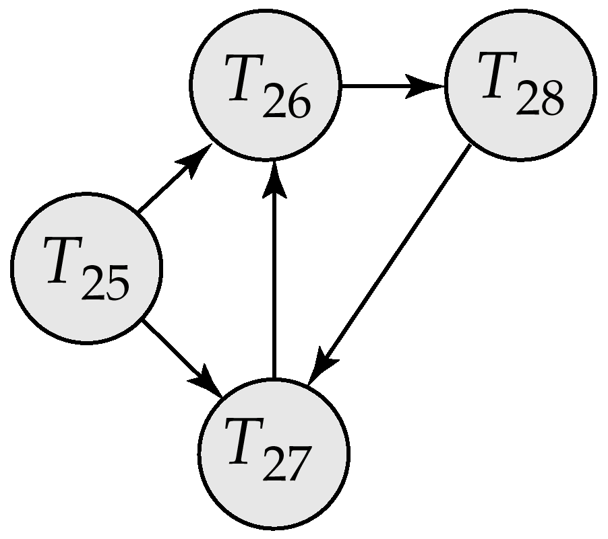
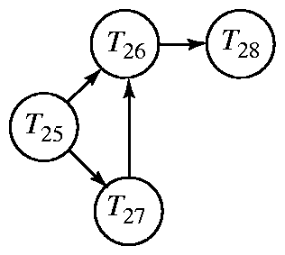
Dealing with Deadlock
Notes:
There are a number of approaches to dealing with deadlock.
The most conservative try to prevent it by figuring out in advance who needs what
This is computationally very expensive, so more commonly systems just try to detect it when it happens
To detect deadlock, the system constructs a “wait-for graph”
Each node in the graph represents a transaction, and there is an edge from T1 to T2 if T1 is waiting for a lock held by T2
How can you tell, by looking at a wait-for graph, whether the system is in deadlock?
(Answer: if there is a cycle, the system may be in deadlock)
The system on the left is not in deadlock. T26 will finish, allowing T27 to finish. Then T25 will be able to go
The system on the right is. T26 can’t finish now, because it waits for T28 who waits for T27, who waits for T26
There are a number of deadlock resolution algorithms that decide which transaction to rollback when deadlock occurs (e.g. wait/die and wound/wait). Although they differ in their details, the basic approach is to kill newer transactions, so less work has to be redone.

Slide 31
Locking Multiple Resources
Xact 1 | Time | Xact2
Read balance 1; sum = 40 | 1
Read balance2; sum = 90 | 2
 | 3 | Read balance 3 = 30
 | 4 | Decrement and write balance 3 -> 20
 | 5 | Read balance 1 = 40
 | 6 | Increment and write balance 1 -> 50
 | 7 | COMMIT
Read balance 3; sum = 110 | 8
Notes:
Often a transaction requires multiple fields to be read and written.
You have to be careful here, or you can introduce anomalies, even with locking
Recall this situation, where the total ends up wrong because T2 sneaks in and modifies balance2 after T1 has read it, but before T1 is finished with the calculation based on it.
Locking doesn’t resolve this, assuming that T1 doesn’t ask for the locks until right before he reads the values, and both transactions give up the lock on each object immediately after using it. In that case, the anomaly occurs just the same.
To prevent this, locks in a production database are generally allocated using a more elaborate protocol…

Slide 32
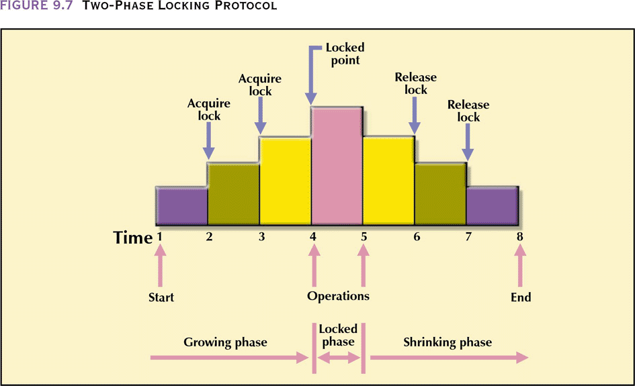
Two-Phase Locking
1) A transaction must acquire all the locks it needs before unlocking any object
2) Once a transaction gives up any of its locks, it may not acquire any further locks.
Notes:
The “two-phase” refers to the acquisition and release phases.
Note that the transaction doesn’t have to wait until it has all its locks to start working
It can get some locks, do what work it can, then get some more locks later
It just never releases any locks until the complete transaction is finished.
Therefore, no other transaction can ever see any of its objects in an intermediate state.
Thus if transaction T1 gets a lock needed by T2, T2 will not see any of the effects of T1 until T1 is completely finished
This is just as though T1 and T2 had run in serial.
Thus two-phase locking guarantees serialisability. There is always some sequence of serial execution to which the interleaved executions will be equivalent.
Specifically, transactions are serialised by the order in which they reach their lock points (proof available)
Unfortunately, two-phase locking is still susceptible to deadlock…

Slide 33
Locking Multiple Resources
Xact 1 | Time | Xact2
Read balance 1; sum = 40 | 1
Read balance2; sum = 90 | 2
 | 3 | Read balance 3 = 30
 | 4 | Decrement and write balance 3 -> 20
 | 5 | Read balance 1 = 40
 | 6 | Increment and write balance 1 -> 50
 | 7 | COMMIT
Read balance 3; sum = 110 | 8
Notes:
If we look at this transaction in a two-phase locking scenario, Transaction 1 holds on to the lock on balance 1 until it is finished, so Transaction 2 can cannot modify its value.
Step 5 cannot occur until step 8 has.
At the same time, Xact2 has balance 3 and won’t let it go, so step 8 cannot occur.
Deadlock
Can you think of a modification to the two-phase locking protocol that is immune to deadlock?
(Answer:
Require all transactions to request locks on objects in the same order, called “serialising the resources”.
Lots of overhead, and lots of wasted time.)
Mostly we do deadlock detection, rolling back one member of a deadlock cycle to break it.

Slide 34
Concurrency Protocol 2: Timestamp Ordering
Each transaction is given a “timestamp” when it initiates
Timestamps are unique and monotonic
For each data object, we store the timestamp of the transaction that most recently accessed it
Conflicts are identified by comparing timestamps
Notes:
No locks, so no waiting, and no deadlock
However, the timestamp ordering protocol relies heavily on restarting transactions that get into conflict.
Sometimes this is more costly than waiting and deadlock management
Date:
The basic idea is that if transaction A starts execution before transaction B, then the system should behave as if A actually executed in its entirety before B started (as in a genuine serial schedule). Thus A should never be allowed to see any of B’s updates; likewise, A should never be allowed to update anything that B has already seen [ because neither of these events could occur if A actually finished before B started]
[implemented as follows] For any given database request, compare the time stamp of the requesting transaction with the timestamp of the transaction that last retrieved or updated the requested object. If there is a conflict [i.e. one of the operations is/was a write] the requesting transaction is restarted with a new timestamp.

Slide 35
Timestamp Ordering
Assume T1 wishes to modify object X which was last modified by T2
If T1 younger than (i.e. started after) T2, T1 proceeds
It T1 is older than (i.e. started before T2), T1 restarts with a new timestamp.
Notes:
This means that either every action in TY will occur after every action in TO (same as if it was serial TO, TY)
Or TO has to start over
Thus TO never sees an intermediate state of TY.
Again, there are a number of extensions to this basic approach that improve performance through adding complexity.

Slide 36
Concurrency Protocol 3: Optimistic Methods
No locking or timestamping
Transactions run in three phases:
Read:
All values are grabbed and computations done
Results saved in a private copy
Validate:
System determines if computations contained a conflict anomaly
If no anomaly, results are committed. If anomaly, transaction is restarted.
Notes:
The optimistic methods are a set of protocols that assume that, really, resource conflicts (RW, WR or WW) don’t occur that often
So the anomalies don’t occur that often
So, why worry about it.
The algorithms for determining if an anomaly occurred are complex and involve computing the dependencies of the set of active data objects.
This is still often more efficient than managing a 2PL or timestamp locking system
The optimistic approach actually works quite well in databases that are read-heavy.

Slide 37
What Is Locked?
Database
Table
Disk page
Row (record)
Field
Complex
Restrictive
Notes:
Throughout this discussion we have talked about locking “database objects”, and our examples have made it look as though locks were applied at the individual field level.
This is not actually true.
The overhead for that in a large database would be too much
Thus, one of the choices we make in DBMS design is the “granularity” of lock
Given what we know about the physical implementation of databases, we could lock at any of these levels.
(E.G. if we lock at the table level, any requests for data from the same table – even different records – are in conflict)
We balance the complexity of the management against the restrictiveness
What would you predict is the most popular locking granularity? (Disk page)
This combines the most efficient hardware protocol with an intermediate state on each of the competing criteria of efficiency and flexibility

Slide 38
Disaster Recovery
Backup :
Makes periodic snapshots of all or part of the database
Journaling :
Makes an audit trail of transactions
Checkpoint:
Periodically halts transactions and synchronises all files and journals
Recovery:
Recreates the database in event of corruption or loss
Notes:
Even if you get your concurrency working perfectly so that transactions don’t corrupt the data, bad things can happen
Your server can melt or get a virus; your building can burn down.
Recall that one of the requirements of transactions is that they be Durable. That is, once committed they stay forever.
So we must be able to get that database back if something catastrophic occurs
To simplify, this is managed by basically backing everything up – not just the contents of the database, but also a record of what things have been done to the database.
At the facilities level, a DBMS usually provides these four: (journaling also called journalizing)
Backup and checkpoint are just what they sound like.
The DBMS provides tools for scheduling them. You will cover this in the DBA practicals.
The interesting one is Journalizing

Slide 39
Disaster Recovery
Journaling
Records information about all transactions since latest backup
In event of failure, transactions can be rerun from latest backup state

Slide 40
Transaction Log
When any transaction causes data modification, the change is first recorded in a special system file.
Only after the transaction terminates successfully are the changes made to the actual database
The transaction log thus:
supports data integrity
makes possible database recovery
Notes:
Whenever a user writes or edits data, SQL Server first records the change
Log records either store the instructions performed, or the store before/after snapshots of the state of the data
Thus “rolling back” is really implemented by “not writing the changes out, and marking this as rolled back in the transaction log”
Can you think of any disadvantages associated with maintenance of transaction logs? (Time and space)
Can you think of any way this approach could fail? (If the logs become corrupted. So they need backed up too)

